Slide 1

Curs 3:
Data Bindings

Slide 2
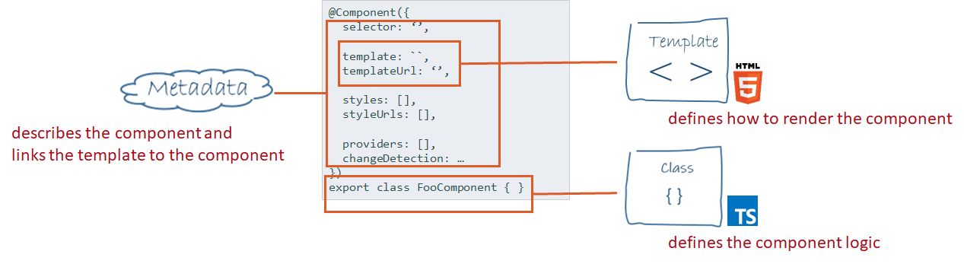
Component definiton

Slide 3
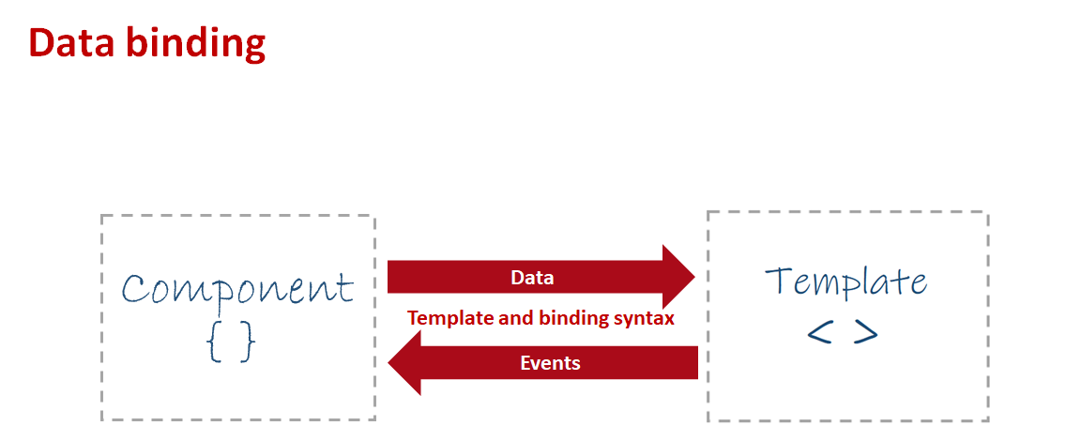

Slide 4
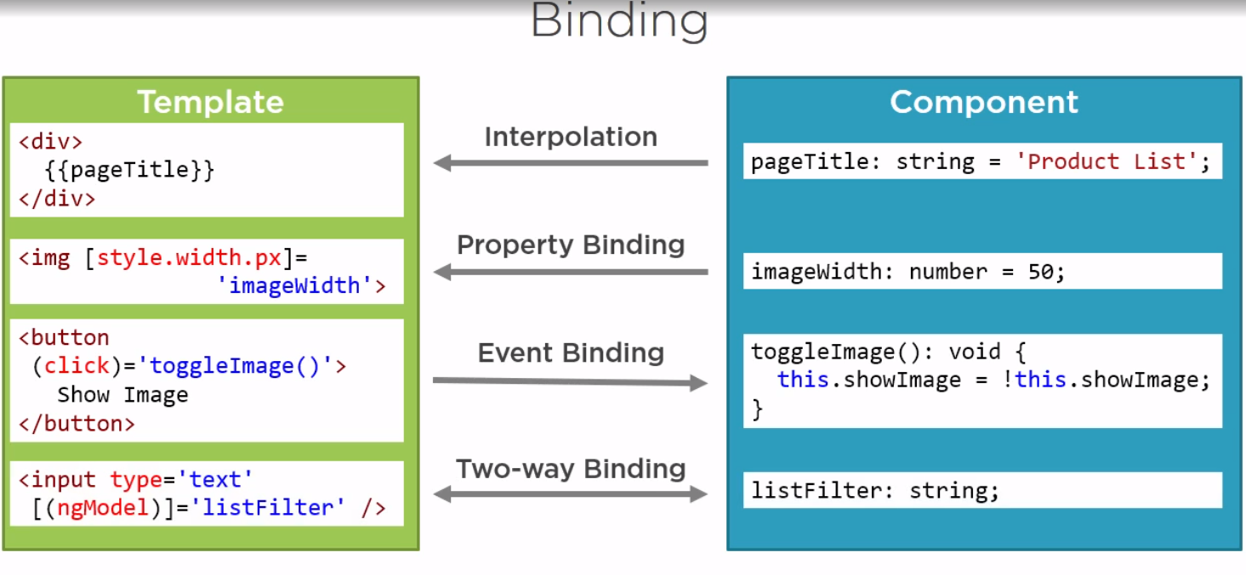

Slide 5
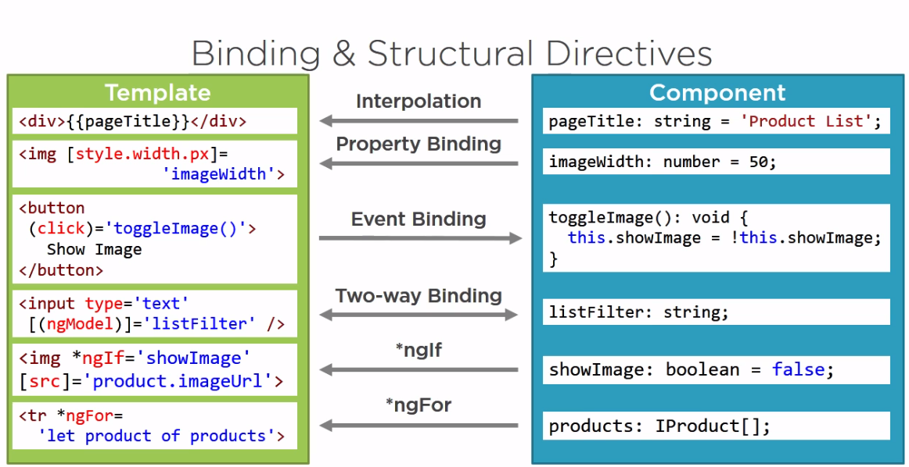

Slide 6
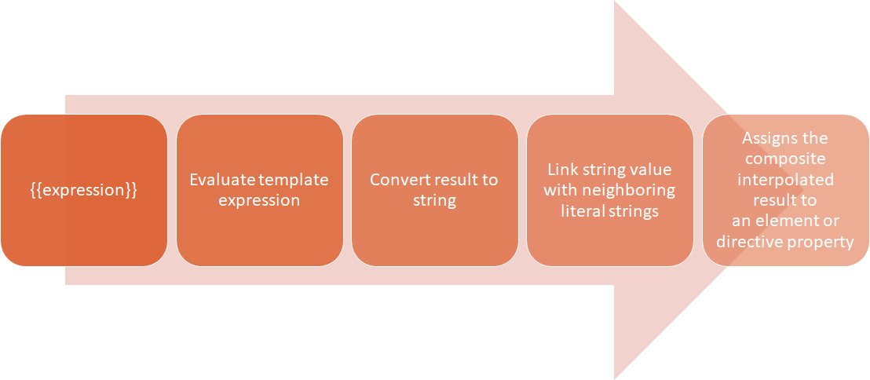
Interpolation
{{ expresion}}

Slide 7
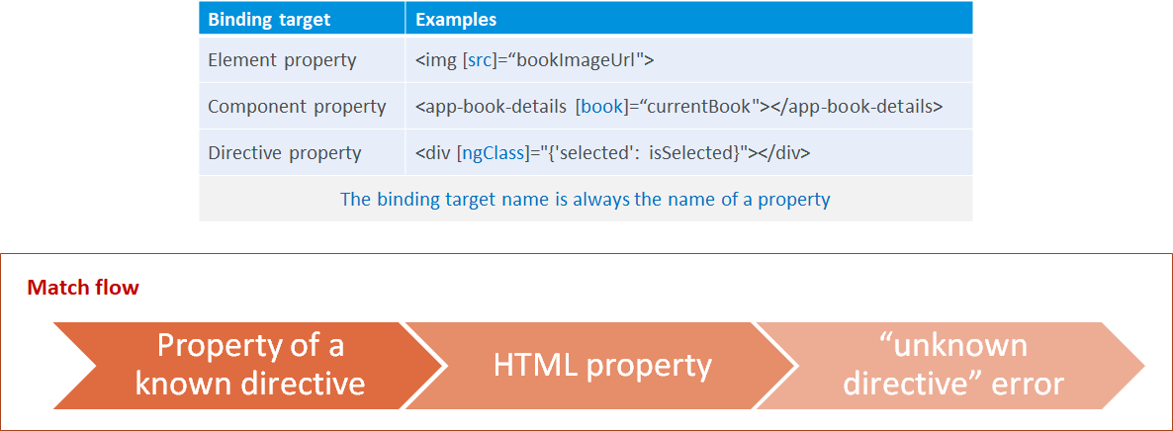
Property Binding
[property]=”expresion”

Slide 8
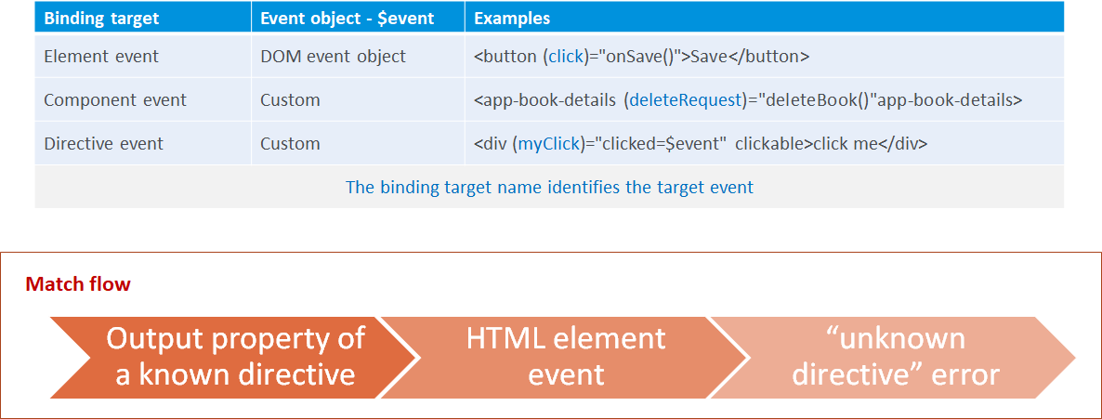
Event Binding
(event)=”statement”

Slide 9
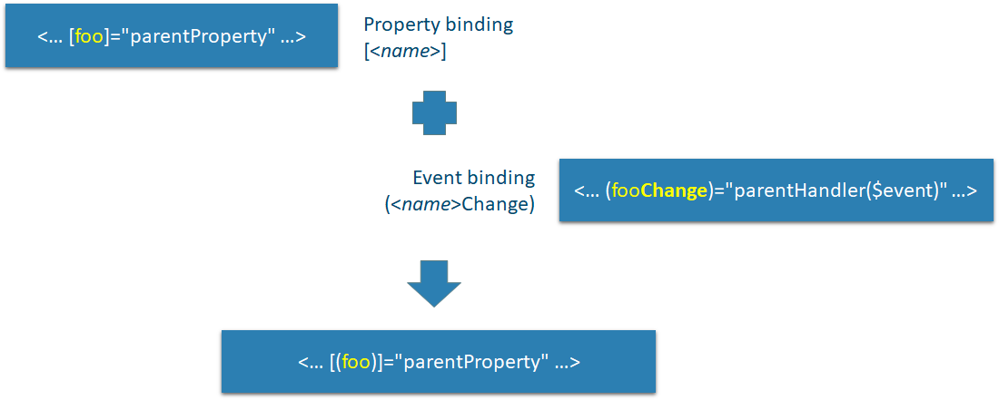
Two-way Binding
[()]

Slide 10
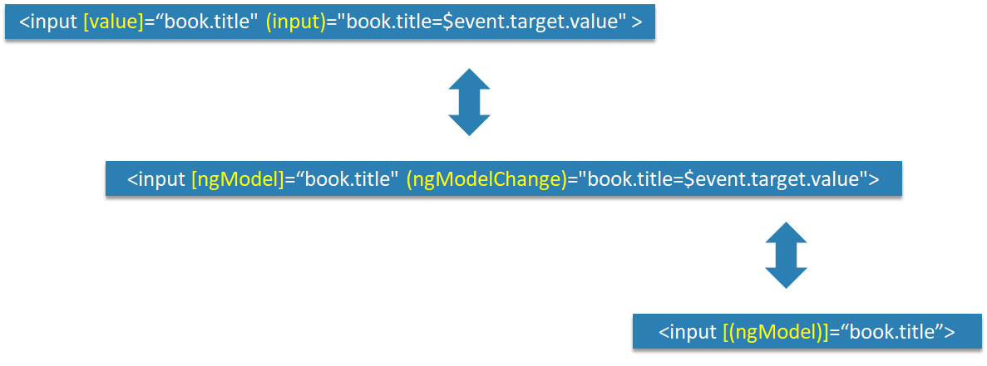
Two-way Binding - ngModel

Slide 11
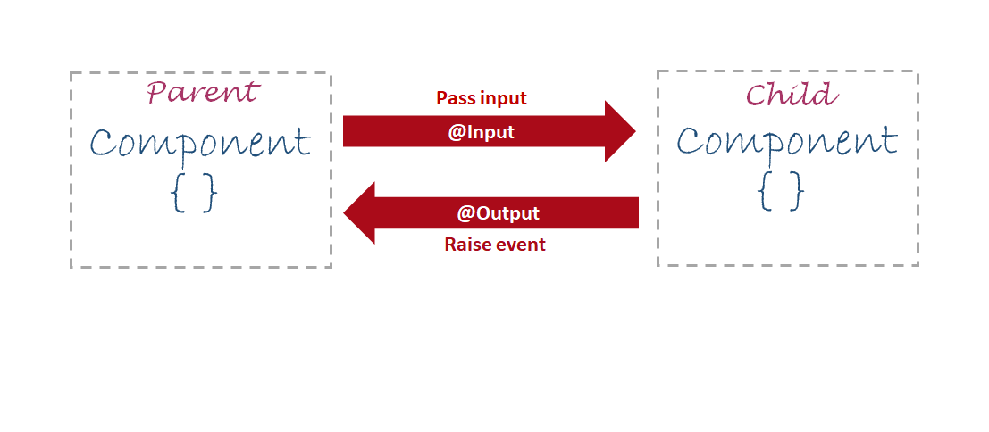
Parent - child communication

Slide 12
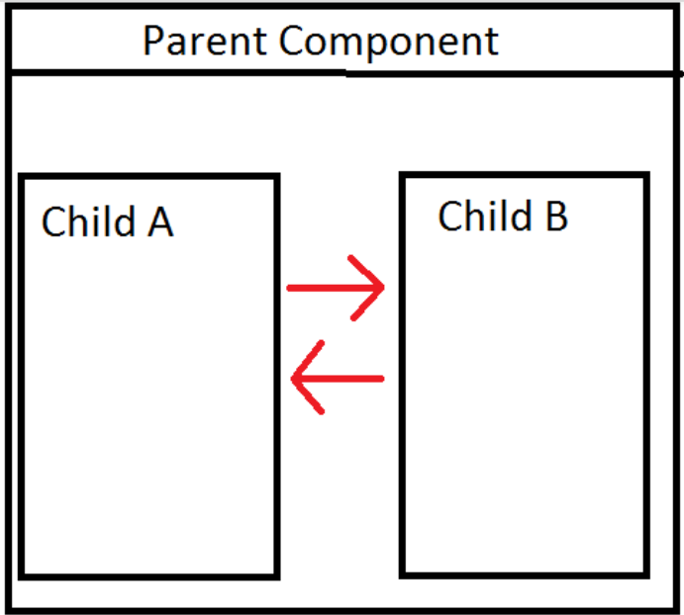
Two-way Binding Between Components

Slide 13
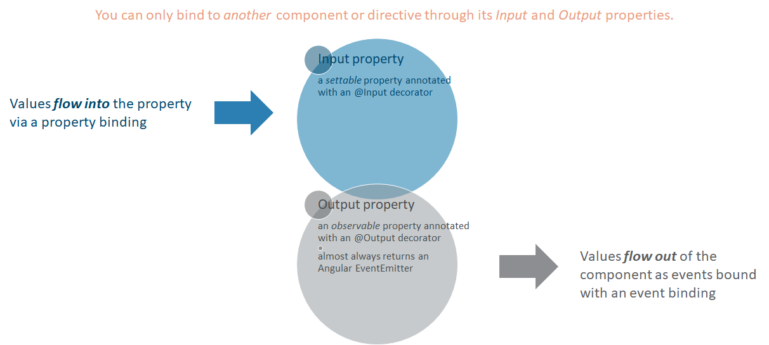
Input & Output properties

Slide 14

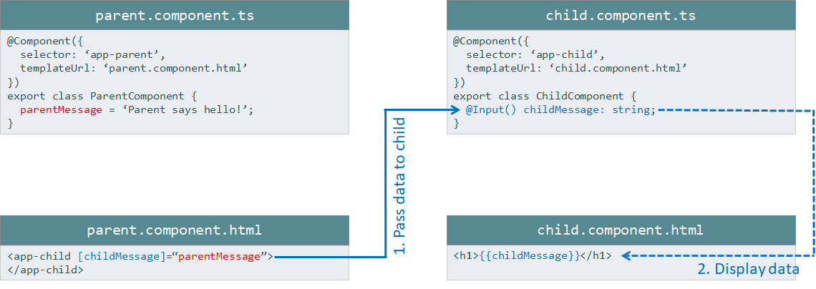

Slide 15
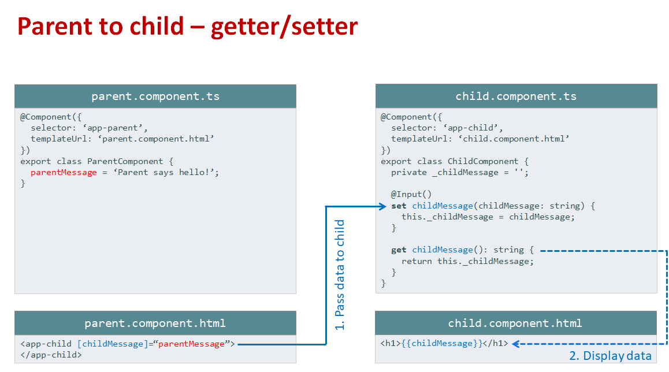

Slide 16
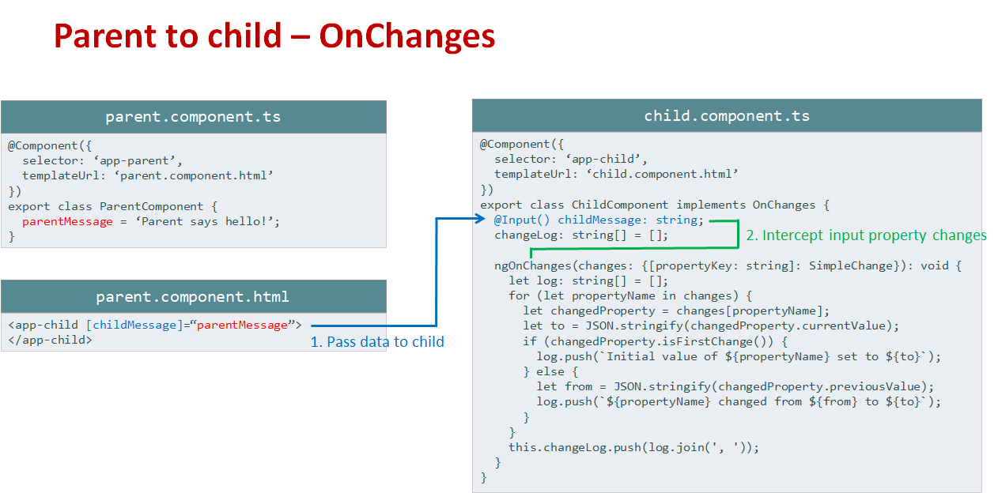

Slide 17
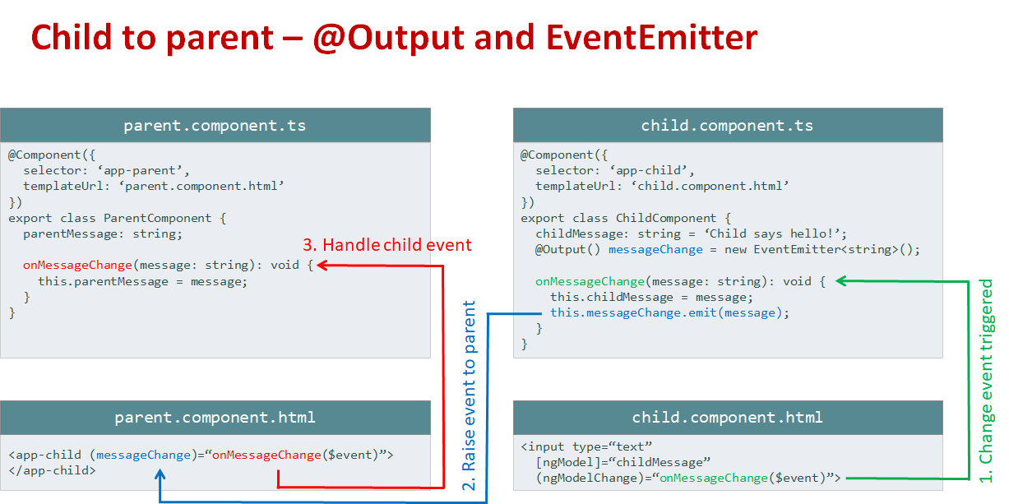

Slide 18
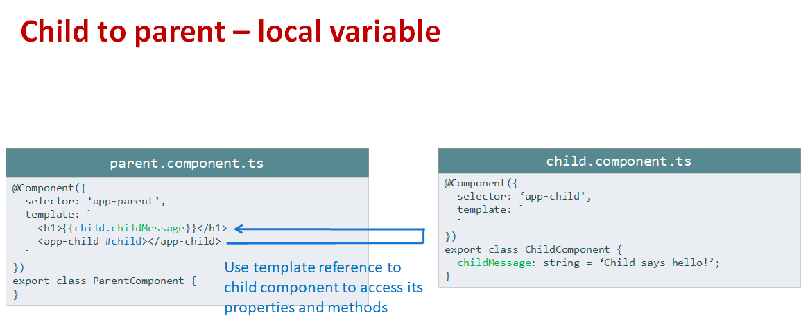

Slide 19
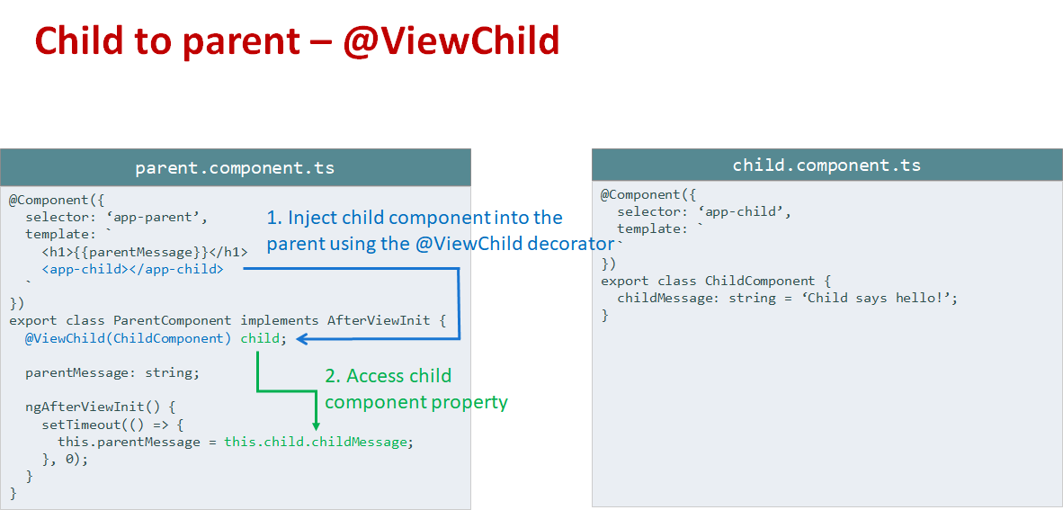

Slide 20
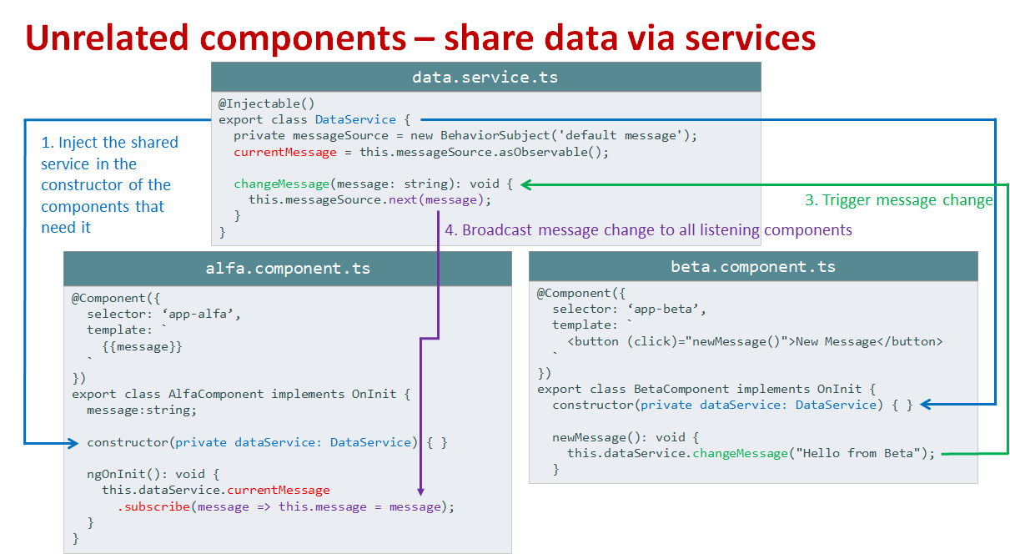

Slide 21
References:
https://jcoop.io/angular-2-practice-exercises/
https://www.youtube.com/watch?v=WWQZCDegWHg&list=PL6n9fhu94yhWqGD8BuKuX-VTKqlNBj-m6
https://www.youtube.com/watch?v=CusfUmB6mkY&list=PL6n9fhu94yhWNJaDgh0mfae_9xoQ4E_Zj
Google.com

